Slide 1
Stop! What is your name?
It is Edoardo Federici, student of CNS!
Notes:
https://docs.google.com/presentation/d/1c_YBoExWB1xjTcHQeht4TPmYE867jWd21YcZvi0WFTA/

Slide 2
What is your quest?
To seek knowledge!

Slide 3
What is the airspeed velocity of an unladen RC?
[1]
What do you mean? Electronic or optical ESN?

Slide 4


Slide 5
Models of Photonic RC
CNS 2020/2021
Physical implementation of RC networks exploiting the properties of optical devices
Edoardo Federici - 61667

Slide 6
Necessary Background

Slide 7
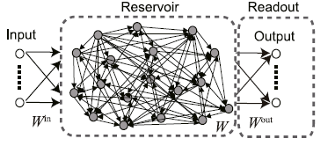
Reservoir Computing
A (fixed!) Reservoir is a dynamical system made of individual units that store information.
Each unit has a non-linear response to the input → the non-linear mapping into a high-dimensional space facilitates classification.
A (trainable!) Readout layer performs a linear transformation of the output of the reservoir (linear/ridge regression). It often has a closed-form solution.

Slide 8
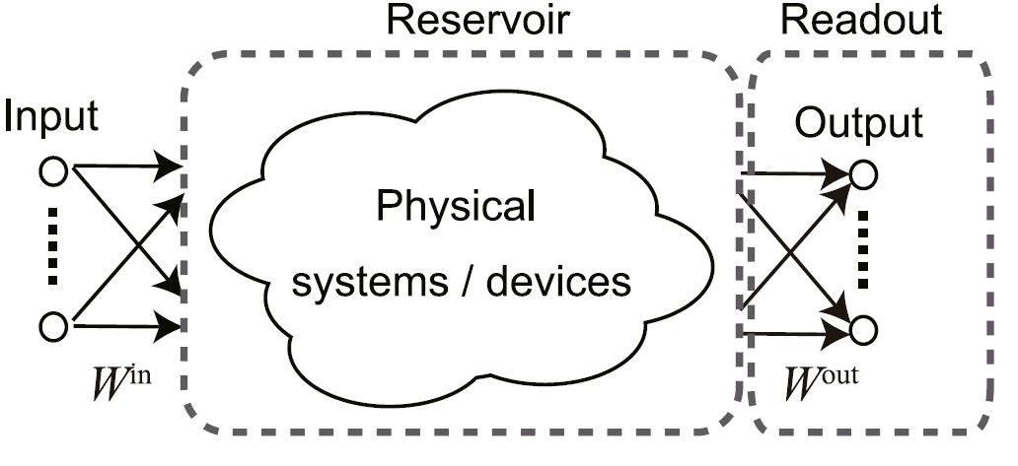
Photonic Computing
Relies on photons (light) instead of electrons (current).
Photons are created by a laser (or a diode) and travel in a fiber optic cable → information flows at the speed of light.
How to handle signals? Classical transistors are replaced by optical switches, created using materials with a non-linear refractive index to create optical logic gates which, in turn, are assembled to build the CPU.
Instead of charging the transmission lines between two logic gates up to the signal voltage, in optical communication just the amount of energy that is necessary to switch the receiving optical transistor is necessary.

Slide 9
Non-linear Optics
<<When a light wave propagates through an optical medium, the oscillating electromagnetic field exerts a polarizing force on all the electrons comprising the medium. Since the inner electrons of the atoms are tightly bound to the nuclei, the major polarizing effect is exerted on the outer or valence electrons. With ordinary light sources the radiation fields are much smaller than the fields that bind the electrons to atoms. Hence the radiation acts as a small perturbation. This produces a polarization that is proportional to the electric field of the light wave. However, if the radiation field is comparable with the atomic fields (~10⁸ V/cm), then the relation between the polarization and the radiation field is no longer a linear one. The requisite light fields needed to exhibit this non-linearity are obtainable with laser sources.>>
Introduction to Modern Optics, Grant R. Fowles, 1968

Slide 10
Why together?

Slide 11
It is possible to implement optical RC either on photonic chips or using diffractive optics:
higher bandwidths
higher parallelism
lower power consumption
wrt digital implementations
!

Slide 12
Spatially distributed PRC

Slide 13
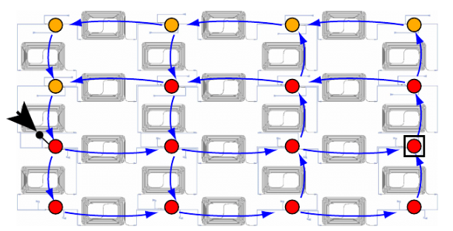
On chip silicon computer
It is a 16-node square mesh reservoir with multiple feedback loops.
Coupling and splitting between the nodes is done with a combination of multimode interferometers (purely passive components).
The amplified responses are measured using an optical sampling scope and saved to a computer where they were used for offline training.
Where is the non-linearity? In the photodetectors, which essentially square the magnitude of the complex representation of the coherent light signal.
Internally, the time scale of the network is set by the optical interconnection delay and determines how much memory it has of past input signals.
[2]
Notes:
Black arrow: input, Blue arrow: light flow, Red nodes are measured

Slide 14
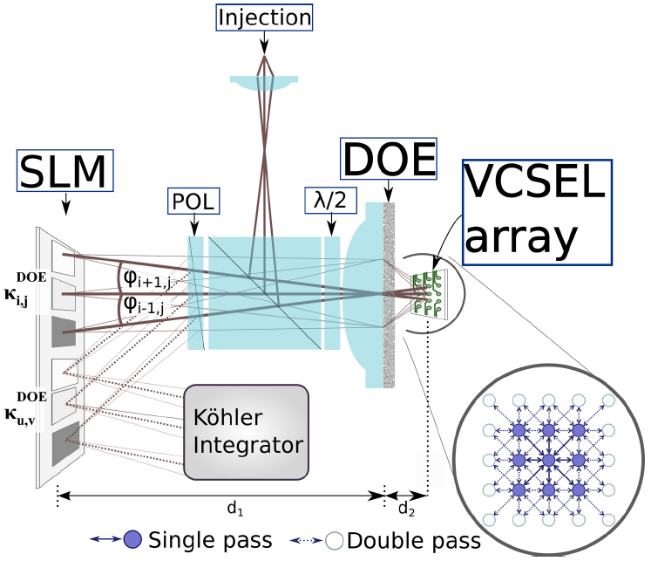
Diffractively Coupled VCSEL
It is a 8x8 array of single mode Vertical-Cavity Surface-Emitting Lasers (diodes, lasers emit light perpendicular to the wafer surface) arranged in a square lattice.
The VCSEL array’s emission passes a diffractive optical element and is imaged onto a reflective spatial light modulator. The DOE’s diffractive side-orders overlap with the diffractive order of their neighboring lasers. By a reflector, the output of the spatial light modulator is then again imaged onto the laser-array, where the overlapping orders result in coupling between neighboring emitters. Finally it passes through a Köhler-Integrator that allows to focus it on a single spot where it is detected.
[3]

Slide 15
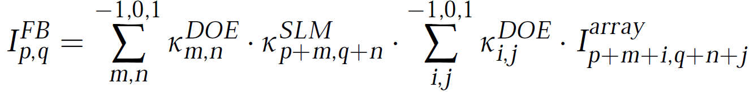
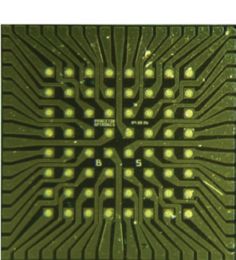
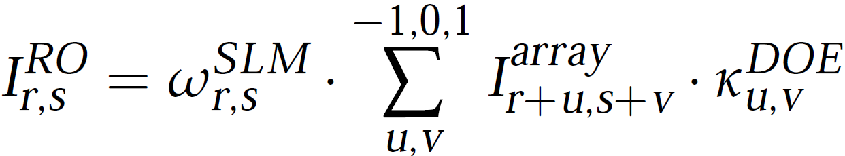
Diffractively Coupled VCSEL (2)
Input: Laser injection.
Reservoir: feedback loop between VCSEL array coupled with the input and the (scaled) SLM reflection of both, creates virtual states:
Readout: homogenized by the Kohler integrator and detected by a multi-mode optical fiber:
[3]
Notes:
k:efficiency

Slide 16
Delay Based PRC

Slide 17
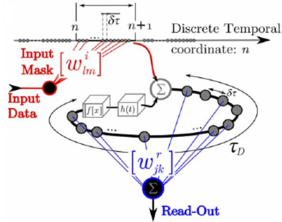
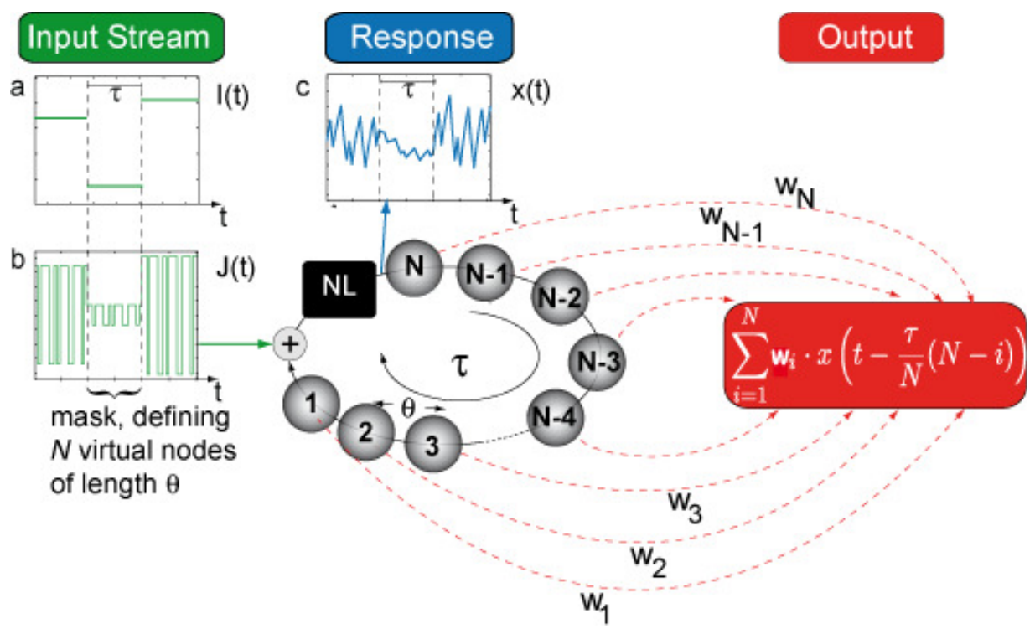
Single Dynamical Node
The discrete input stream is transformed into a piecewise continuous function I(t) using a sample-and-hold procedure (τ, the delay in the feedback loop). This input is multiplied by the mask M(t) (piecewise constant over θ = τ/N and periodic over τ). (≠ classical RC) The resulting function J(t) = I(t)M(t) is multiplied to the input scaling γ and added to the current state x(t-τ). Finally, a linear combination of the values of the N virtual nodes (characterize the transient response of the reservoir to a certain input at a given time) is taken to obtain the output.
[4]
Notes:
A reservoir is obtained by dividing the delay loop into N intervals and using time multiplexing.
A drawback of photonic reservoirs is that a compact design results in short time delays; hence, the required input and readout operation rates may be too high for practical implementation. A digital mask modulation technique was reported to greatly alleviate this problem

Slide 18
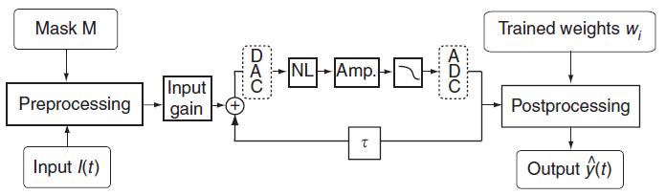
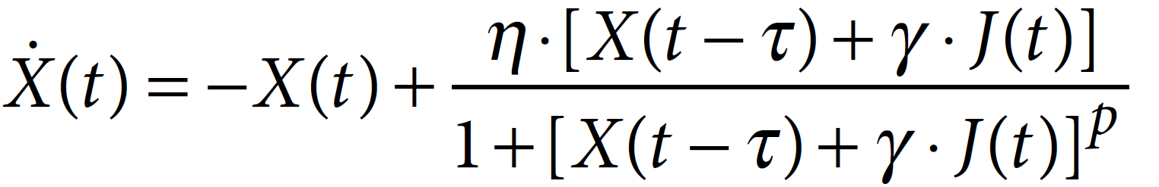
Single Dynamical Node (2)
A Mackey–Glass oscillator is used to model this SDN. It is extended to include the external input J(t).
The evolution of the state is described by:
where η is the feedback strength
If T<<θ, x(t) is only determined by the instantaneous value of the input J(t) and the reservoir state x(t-τ): there is no coupling between nodes.
We can identify three time scales: - θ for virtual nodes separation - τ for the delay line - T for the Mackey–Glass system
Best performance is for θ <≈ T << τ
If θ<T, x(t) depends on the states of the previous virtual nodes and doesn’t take into account the instantaneous values of the feedback and of the input.
Notes:
A reservoir is obtained by dividing the delay loop into N intervals and using time multiplexing.
A drawback of photonic reservoirs is that a compact design results in short time delays; hence, the required input and readout operation rates may be too high for practical implementation. A digital mask modulation technique was reported to greatly alleviate this problem

Slide 19
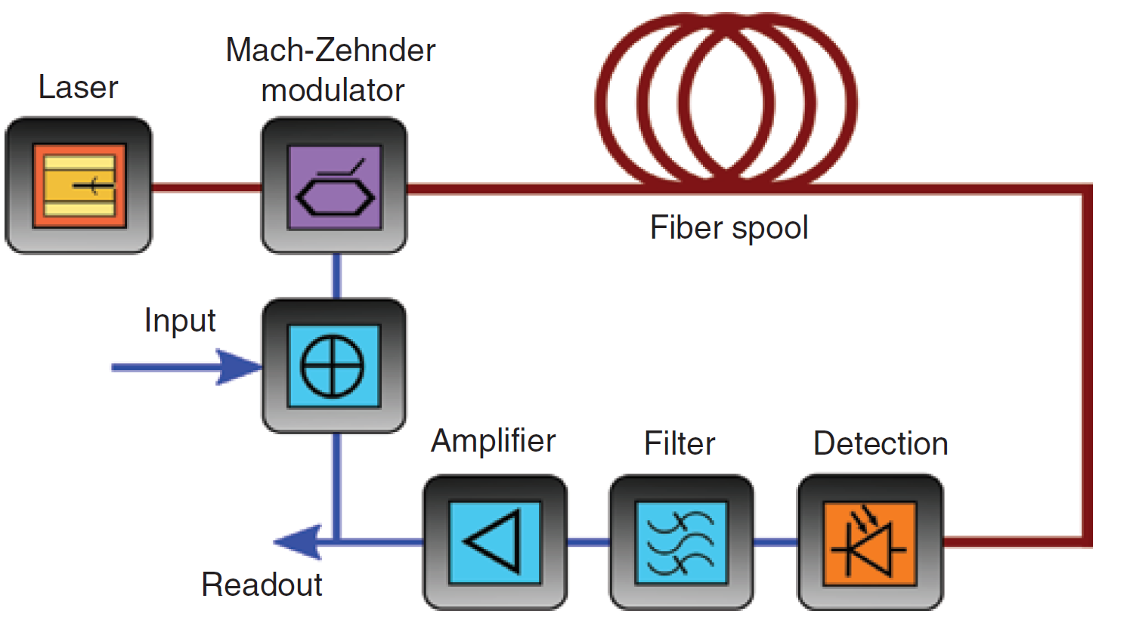
Optoelectronic delay based RC
The optical part of the setup, which is fiber based, includes a laser source, a Mach-Zehnder modulator, and a long optical fiber spool. The Mach-Zehnder modulator provides the nonlinear modulation transfer function, while the long optical fiber provides the delayed feedback loop.
The electronic part of the setup is typically composed of a photodiode, a filter, and an amplifier. The injection of the external input and the extraction of the system output are both done in the electronic part.
Notes:
https://www.synopsys.com/glossary/what-is-a-mach-zehnder-modulator.html

Slide 20
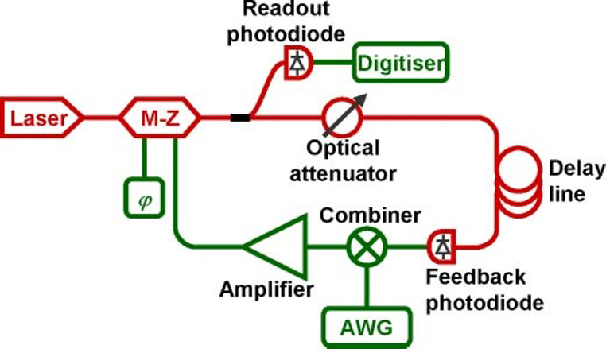
Optoelectronic delay based RC (2)
A computer generates the input signal for a task and feeds it into the system using the arbitrary waveform generator (AWG). The response of the system is recorded by a digitiser and retrieved by the computer which optimizes the readout function in a post processing stage. The feedback gain a is adjusted by changing the average intensity inside the loop with the optical attenuator. The input gain b is adjusted by changing the output voltage of the function generator by a multiplicative factor. The bias Q is adjusted by using a DC voltage to change the operating point of the M-Z modulator.
optical
electrical
[5]

Slide 21
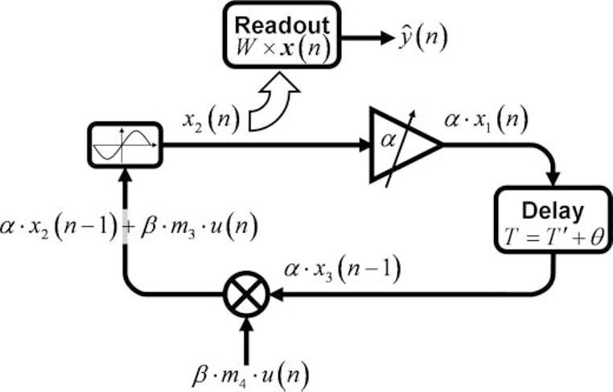
Optoelectronic delay based RC (3)
Information flow:
Four reservoir nodes at five different stages of processing. Starting from the bottom, and going clockwise, a input value u(n) gets multiplied by an input gain β and a mask value m_{i}, then mixed with the previous node state αx_{i-k}(n-1). The result goes through the sine function to give the new state of the reservoir x_{i}(n), which then gets amplified by a factor α and, after the delay, will get mixed with a new input u(n+1). All the network states x_{i}(n) are also collected by the readout unit, multiplied by their respective weights W_{i} and added together to give the desired output y(n).
^
[5]

Slide 22
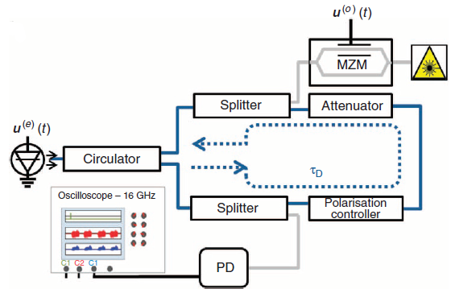
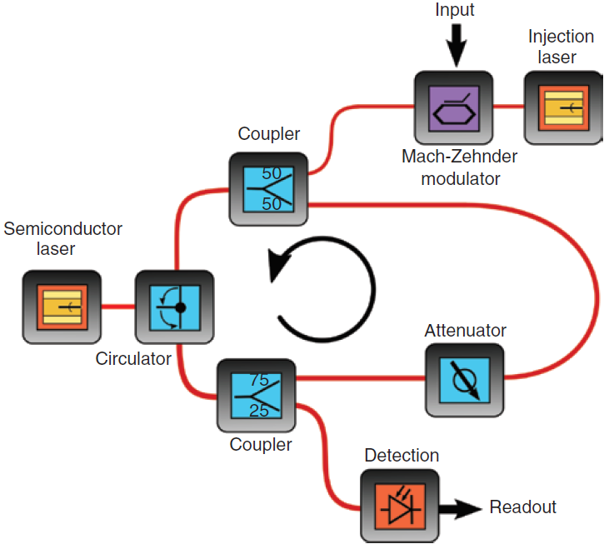
All optical delay based RC
A semiconductor laser is subject to the injection of a modulated laser (external input) and an optical feedback loop with a delay τ forming the reservoir.
This reservoir computer was used to classify spoken digits and to forecast chaotic time series with high accuracy (NARMA).
The transient states are obtained by delayed optical feedbacks.
The non-linearity is actively obtained thanks to the polarisation controller.
[6]

Slide 23
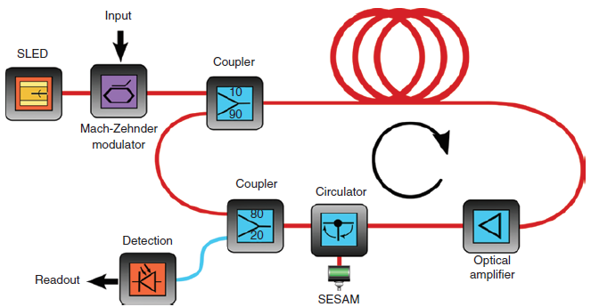
All optical delay based RC (2)
The input optical signal is injected into the ring cavity through a fiber coupler.
The cavity itself consists of a fiber spool used as a delay line, an optical amplifier, a circulator, and a SESAM (semiconductor saturable absorber mirror, a non-linear passive element).
A fiber coupler is used to send 20% of the cavity intensity to the readout photodiode.

Slide 24
The two main advantages offered
by photonic hardware implementations of RC are low power consumption and high processing speeds.
Semiconductor lasers exhibit a non-linear interaction between the laser field and semiconductor medium, resulting in complex behaviour when subjected to feedback, electrical modulation or optical injection.
Thank you for your time

Slide 25
[1] https://youtu.be/uio1J2PKzLI
[2] Vandoorne K, Mechet P, Van Vaerenbergh T, et al. Experimental demonstration of reservoir computing on a silicon photonics chip. Nat Commun 2014;5:1–6.
[3] Brunner D, Fischer I. Reconfigurable semiconductor laser networks based on diffractive coupling. Opt lett 2015;40:3854.
[4] Larger L, Soriano MC, Brunner D, et al. Photonic information processing beyond turing: an optoelectronic implementation of reservoir computing. Opt Express 2012;20:3241–9.
[5] Soriano MC, Ortín S, Brunner D, et al. Optoelectronic reservoir computing: tackling noise-induced performance degradation. Opt Express 2013;21:12–20.
[6] Brunner D, Soriano MC, Mirasso CR, Fischer I. Parallel photonic information processing at gigabyte per second data rates using transient states. Nat Commun 2013;4:1364.
[7] G. Van der Sande, D. Brunner, and M.C. Soriano. Advances in photonic reservoir computing. Nanophotonics, 6(3):561ñ576, 2017.
[8] Tanaka, Gouhei, et al. "Recent advances in physical reservoir computing: a review." Neural Networks (2019).
[9] L. Appeltant, M.C. Soriano, G. Van der Sande, J. Danckaert, S. Massar, J. Dambre, B. Schrauwen, C.R. Mirasso, I. Fischer. Information processing using a single dynamical node as complex system. Nature communications, 2, 468, 2011.
[10] Y. Paquot, F. Duport, A. Smerieri, J. Dambre, B. Schrauwen, M. Haelterman, S. Massar. Optoelectronic reservoir computing. Scientific reports, 2, 2012.
[11] De Marinis, Lorenzo, et al. "Photonic neural networks: a survey." IEEE Access 7 (2019): 175827-175841.

